Slide 1
1. Any news from you?
2. My news
3. Homework checking

Slide 2
2. My news

Slide 3
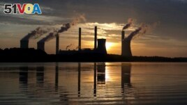
International Agency: 2022 Had Biggest Release of Carbon Dioxide
By Dan Friedell
02 March 2023
FILE - In this June, 3, 2017, file photo, the sun sets behind Georgia Power's coal-fired Plant Scherer, one of the nation's top carbon dioxide emitters, in Juliette, Ga. (AP Photo/Branden Camp, File)

Slide 4
International Agency: 2022 Had Biggest Release of Carbon Dioxide
Who is the agency?
What does “:” mean?
How big is the release?
Why? Or What caused the biggest release?

Slide 5
An international group based in Paris (Who) says (“:”) the world produced a record (biggest release) amount of carbon dioxide last year (2022).
The International Energy Agency (IEA) (Who) said Thursday (when) that the amount of carbon dioxide gas produced around the world rose by 0.9 percent (how big) in 2022 (not when).
Burning fossil fuels, such as oil, natural gas and coal, releases carbon dioxide. The gas is also produced by life on Earth and plants use it to grow. (Why or the cause).

Slide 6
Scientists believe carbon dioxide traps heat and increases the world's temperature. Some experts say high temperatures can cause bad weather events such as a lack of rain and storms.
Climate scientists are concerned about the IEA report. They say people around the world must cut carbon emissions to reduce the world's temperature.

Slide 7
Rob Jackson is a professor of earth system science at Stanford University. "Any emissions growth – even one percent – is a failure," he said, adding that even keeping emissions the same year to year is a problem.
"It's cuts or chaos for the planet. Any year with higher coal emissions is a bad year for our health and for the Earth," he said.

Slide 8
Increased use of coal for energy has caused some of the emissions growth. Many countries switched from natural gas to coal as gas prices rose in 2022. Natural gas became more costly as many nations stopped buying gas from Russia because of the country's invasion of Ukraine.
Emissions from oil also went up but were lower than the years before the COVID-19 pandemic. Much of the increase came as people returned to airplane travel after staying home for much of 2020 and 2021.

Slide 9
While 2022 set a record, experts said the amount of carbon dioxide was lower than expected. They said pandemic restrictions in China, the increase in electric vehicles, solar power and new heating systems prevented emissions from rising higher.
Fatih Birol is IEA's executive director. Birol said "without clean energy, the growth in carbon dioxide emissions would have been nearly three times as high."

Slide 10
Birol said the use of fossil fuels is still too high and oil companies are making a lot of money. The fossil fuel companies, Birol said, need to "take their share of responsibility, in line with their pledges to meet climate goals."
John Sterman leads the Sloan Sustainability Initiative at Massachusetts Institute of Technology. He said it is still possible to reach climate goals.

Slide 11
He said countries around the world must stop cutting down trees, continue to help people buy electric cars and pay for new home heating systems. He argued that renewable energy needs government payments to support it and businesses that produce carbon dioxide should face increased costs.
He called it "a massive, massive undertaking."
I'm Dan Friedell.

Slide 12
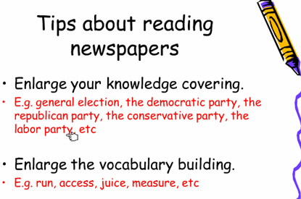

Slide 13


Slide 14
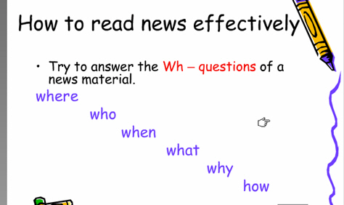

Slide 15
Step 1: Guess the main idea
Analyze the headline:
Ecologists Outline Necessary Actions (for Mitigating and Adapting to a Changing Climate)
Who
What
Why
When: ? Where: ? How: ?

Slide 16
Prediction of Contents：
Is it necessary to mitigate and adapt to a changing climate? If Yes. Why it is necessary?
What kind of actions have been outlined? How to mitigate a changing climate? How to adapt to a changing climate.
Will these actions work?
….

Slide 17
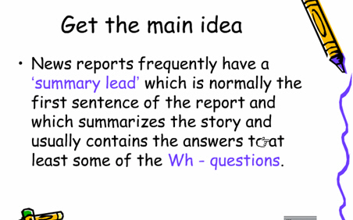

Slide 18
Read the news lead:
1st sentence: Global warming may impair the ability of ecosystems to perform vital services
(Is it necessary to mitigate and adapt to a changing climate? If Yes. Why it is necessary?)
It provides background information about the harm brought by the changing climate.

Slide 19
Read the news lead:
2nd sentence: In a statement released Jan. 26 (when), the Ecological Society of America (ESA) (who) outlines strategies that focus on restoring and maintaining natural ecosystem functions (what) to mitigate and adapt to climate change (why).
It provides more details of some Ws.

Slide 20
Compare the headline and the lead
Ecologists Outline Necessary Actions (for Mitigating and Adapting to a Changing Climate)
In a statement released Jan. 26, the Ecological Society of America (ESA) outlines strategies that focus on restoring and maintaining natural ecosystem functions to mitigate and adapt to climate change.

Slide 21
Step 2: Understand the main meaning
《大学英语课程教学要求》教育部
一般要求：一般题材70词/分钟精读，100词/分钟泛读
较高要求：英语报刊70词/分钟精读，120词/分钟泛读
650 words totally；News body: 600 words: 5-6 minutes
Extensive reading: Get to know the main meaning of major parts of the news.

Slide 22
Structure of the news body
Number all the paragraphs and divide the article to three parts from the third paragraph and summarize their main idea.
Part 1: ______ paragraph ( 3 to ___)
Part 2: ______ paragraph (___ to ___)
Part 3: ______ paragraph (___ to _15__)

Slide 23
Where to put them?
Four approaches to
limiting adverse
effects of
climate change
Four adaptation
strategies
to safeguard
ecosystem services
News?
Quotations to illustrate the
fact of the rising
temperature to emphasize
the importance of these actions.
Notes:
What is the logical order of the these information according to their importance

Slide 24
Quotations to illustrate the fact
4 strategies
4 approaches
Climate
Change
Notes:
The most important the closest to the focus, the least important the farthest to the focus.

Slide 25






Step 3: Get more details
Skimming
1
Focuses of the strategies？
2
Approaches recommended
by ESA?
3
A straightforward way?
4
Four adaptation strategies?
5
Something crucial to both
Environment and public health
Notes:
Pair work and compete for the chance to give answers

Slide 26
About Quotes:
Para 2: Quotes from ESA President to emphasize the importance to take swift actions
Para 13-15: Quotes from ESA Statement and the fact of the rising temperature to emphasize the importance of these actions.
Functions of direct quotes:
Objectivity, factuality…
Notes:
直接引语作用
一、增强新闻真实性和现场感。
二、画龙点睛，彰显人物个性
三、借口说话，表达立场
四、活泼版面，美化新闻。
五、增强传播效果，反映时代特征。

Slide 27
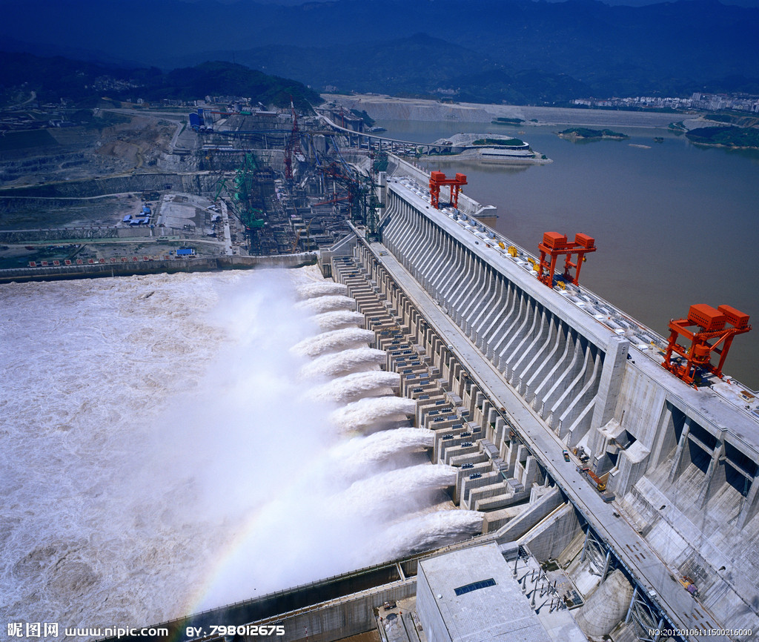
Influence---- Blessing or woe?

Slide 28
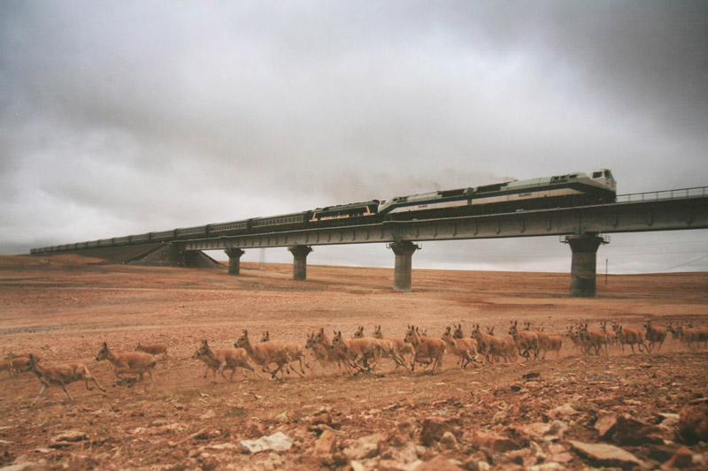
Animal migration on Tibet Plateau

Slide 29
After-reading thoughts and discussions：
Do these actions really work? If yes, how will they work?
After-reading Activity

Slide 30
Homework
Finish Word Building by referring to “Vocabulary in Unit 1”. Check the answers by yourself.
Review Unit 1 and Finish Further Reading on page 9 and Supplementary Reading on Page 12 (the headline and the lead only) and finish the exercises after it on the website before this week.
第一单元学习平台阅读作业 http://202.117.216.244
两个小时答题时间，只允许做一次。

